Slide 1
Project 1: The wonderful world of wine (reviews)

Slide 2
Group 2 Team Members
Chris Armstrong
Cole Travers
Adelia Torres
Andy Shi
Nyarai Nhamoinesu

Slide 3
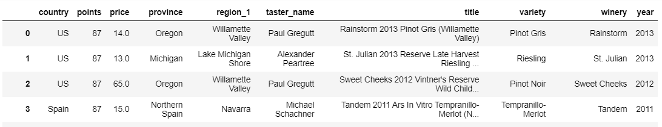
About the data
Initial data collected from https://www.kaggle.com/zynicide/wine-reviews
Our original dataset contained 129971 records of wine reviews scrapped data was scraped from WineEnthusiast on November 22nd, 2017
We pulled the year info from the title column and dropped any incomplete records leaving us with 66096 records for comparison.
We wanted to look at the where, what type, who, and how much

Slide 4
Bigger Questions from the data
California is known for wines, but do they produce the highest quality (professionally rated) wine compared others?
Does California have the best (top rated) wineries compared to the rest of the world?
How does California wine reviews compare to the rest of the world when it comes to the variety of wines reviewed?
Are California wines a better value (price vs review rating) than other wines reviewed?
Where should you really go for a good wine tour?

Slide 5

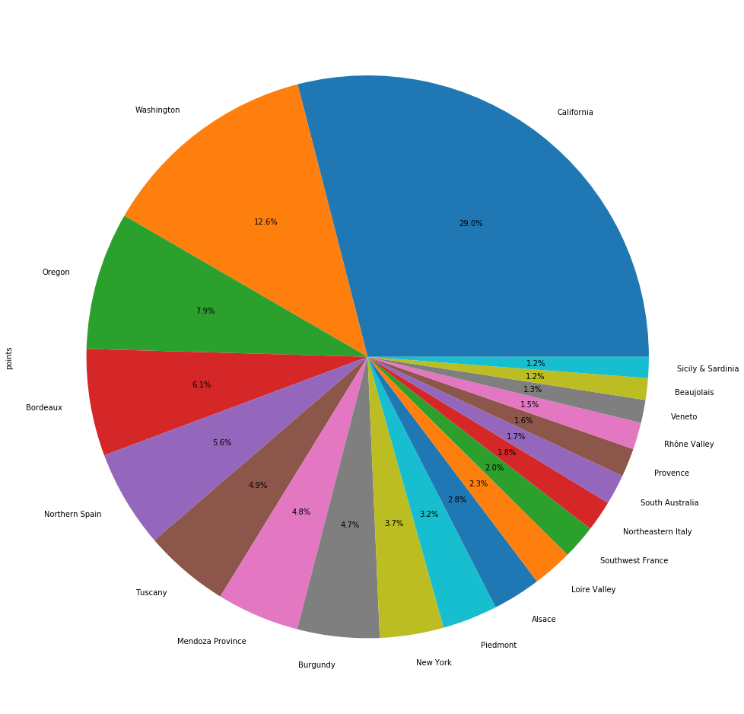
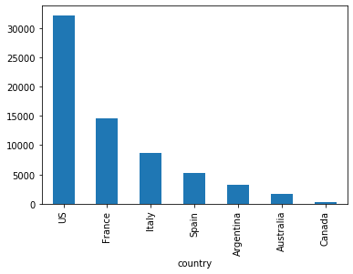
Breakdown of Reviews
Of the 66K reviews remaining, there were 61 distinct state/provinces.
Of the top 20 state/provinces of origin (tot=59,433 reviews), California comprised 29% of the reviews (17,242 reviews) and 26.08% of total reviews while the US as a whole made up 48.8% of the total review.

Slide 6
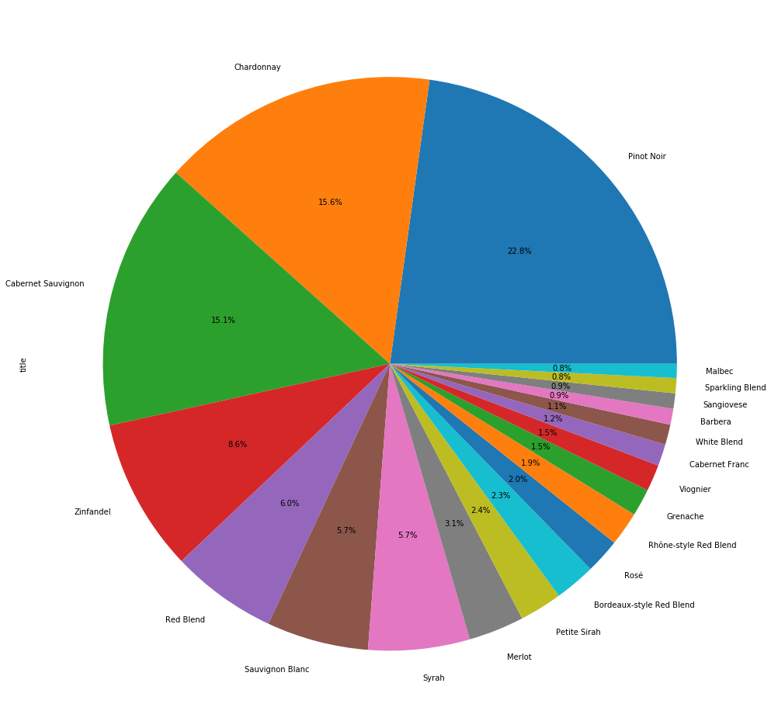
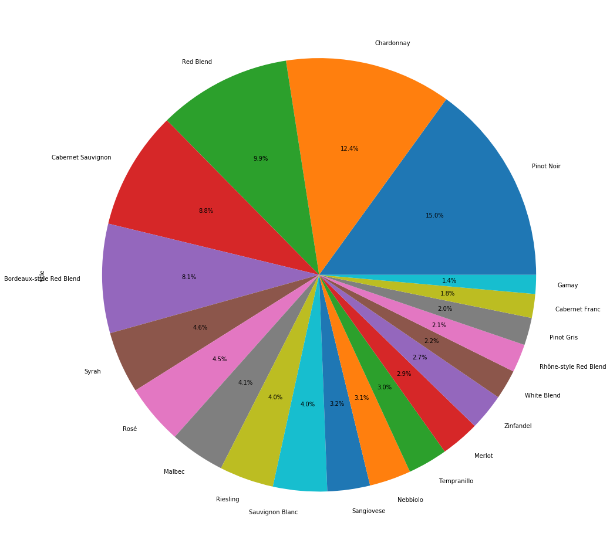
California vs the world by type of wine

Slide 7
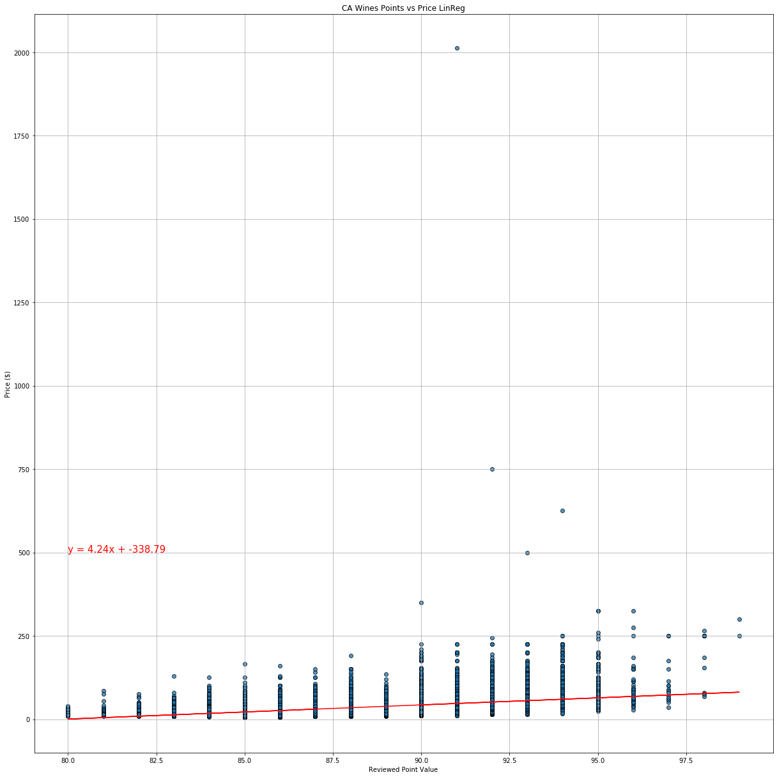
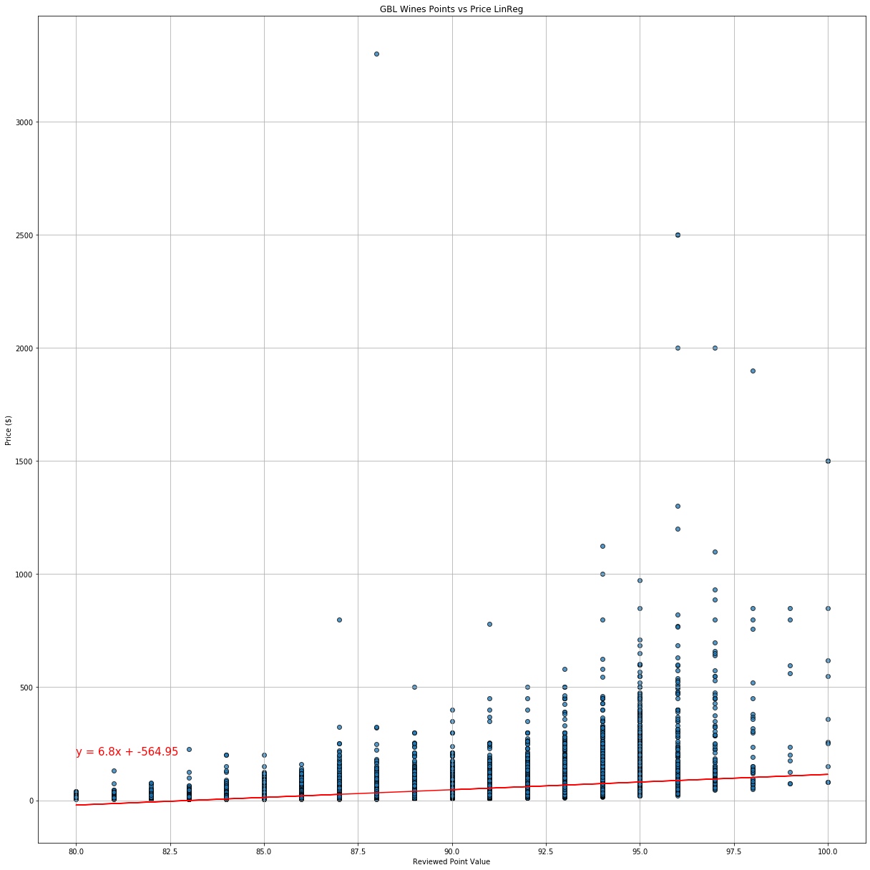
California vs the world by price of wine

Slide 8
Project Description/Outline:
Wine Data Analysis
Hypothesis of our project:
USA has the highest average rating of wines.
Research Questions to Answer:
Top 10 wineries based on the points scale?
Top 10 bottles by price?
Comparison of country of origin vs rating
Countries by winery (top 10 shown in our bar graph)
Winery by location (heat map)
Comparison by price and rating.
Show USA regions with wineries by percentage (pie chart)
Implications of our data:
Our data supports our hypothesis.
Datasets to be Used:
Wine Reviews : https://www.kaggle.com/zynicide/wine-reviews
Rough Breakdown of Tasks:
Review the datasets for enough data
Total of 6 to 8 visualizations (at least 2 visualizations per questions)
Coding
Begin PPT presentation outline.

Slide 9
Research Questions - Completed
Research Questions to Answer vs Visualizations:
Some data Cleanup
CA, Global including CA, Global excluding CA
Pie charts
Scatter Plots
Linear Regressions

Slide 10
Hypothesis: California has the best rated wines – Partly Done- Complete
1. Does spending more get you better wine?
ANSWER:
Viz: 2 Scatter Plots (one with the regression line/one without)
Title :
x_axis : point value
y-axis : price
Notes: IQR for this to be added
2. Does spending more get you better wine?
ANSWER:
Viz: 3 pies
Title :
x_axis :
y-axis :

Slide 11
Hypothesis: California has the best rated wines
3. Do they have the best rated because they have higher diversity of wines?
ANSWER:
Viz: Bar
Title : Top 10 Provinces by variety count
y_axis : # varieties
x-axis : province (only show top 10)
4. Do have the best rated because their wineries fall top 20 wineries by points.
Answer:
Viz: Bar
Title: Top 20 wineries by Average point
x_axis: most reviewed wineries
y_axis: average review
Implication:

Slide 12
Hypothesis: California has the best rated wines
5. Do have the best rated because they have a high number of distributions of reviews by year.
Answer:
Viz: line
Title: Distribution of reviews by year
x_axis: Year
y_axis: Count of reviews

Slide 13
Checklist
Proposal
Presentation
6 to 8 visualizations
API – Optional
Coding – matplotlib,pandas
Implications of our finding/story

